Slide 1

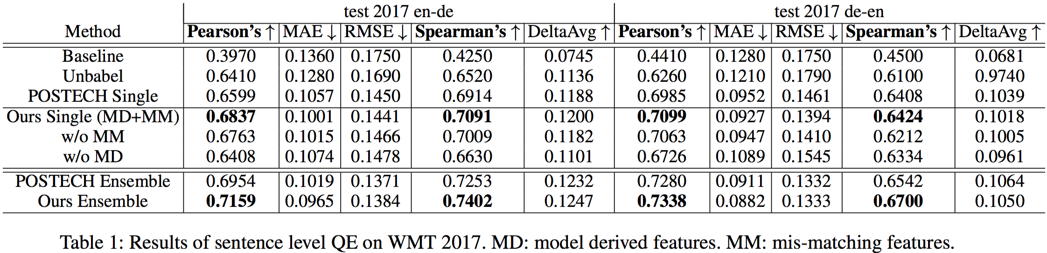
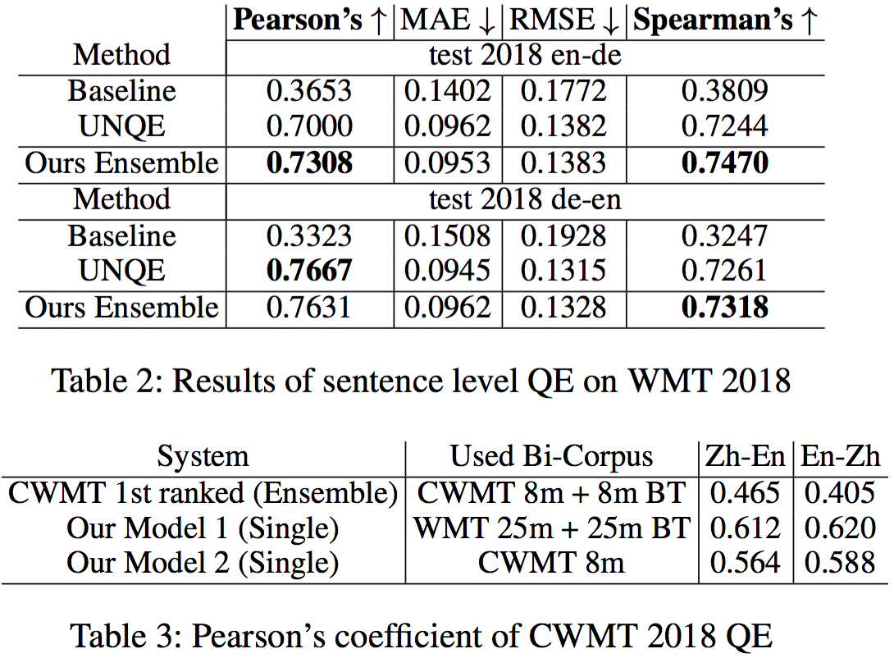
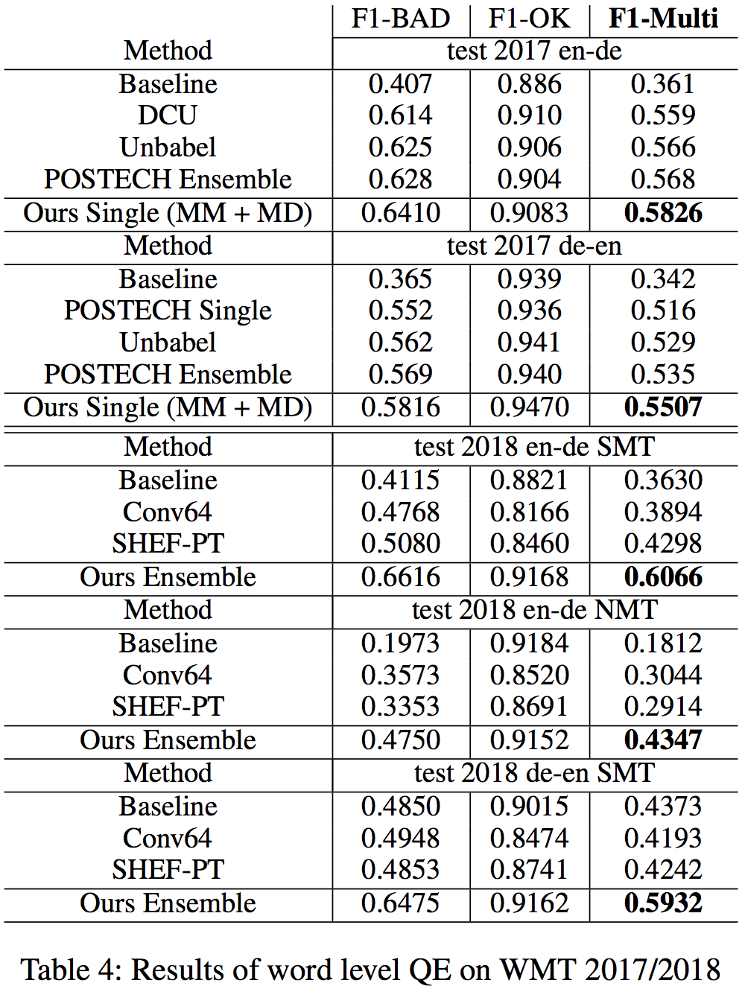
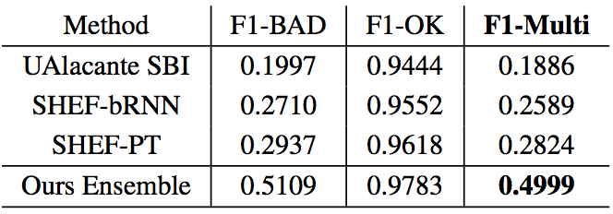
“Bilingual Expert” Can Find Translation Errors
Kai Fan*, Jiayi Wang*, Bo Li*, Fengming Zhou, Boxing Chen, Luo Si
Alibaba Machine Intelligence Technology Lab
Our model structure is a two-staged neural model with a Bi-directional Transformer Feature Extractor and a Bi-LSTM Quality Estimator. A conditional target language model is first built with a novel bidirectional transformer, named neural Bilingual Expert, which is pre-trained on parallel corpora for feature extraction. For QE inference, it can simultaneously produce the joint latent representations between the source and the translation, and real-valued measurements of possible erroneous tokens based on the prior knowledge learned from parallel data. Subsequently, the features will be fed into a Bi-LSTM predictive model for quality estimation.
Framework of Machine Translation Quality Estimation Model:
Bi-directional Transformer Feature Extractor & Bi-LSTM Quality Estimator
Experiment Results of QE Models
Table 5: Results of gap prediction on WMT 2018 QE

